Slide 1
1st May 2019 Version 1.0
CHATBOT FOR SFE
PROPOSED NEXT STEPS

Slide 2
CONTEXT
Customers are contacting SFE in high numbers to seek answers to queries about their applications and payments. This drives very high call volumes in the contact centre (around 4M annually). The top query topics are around Application Status and Evidence, which cost around £4M annually to resolve.
In a drive to divert traffic away from the call centre and channel-shift towards digital channels, social media teams have been established where customers can contact SFE advisors through Facebook and Twitter.
In the 12 months to March 2019, over 280,000 messages were sent to the social media team. While customer satisfaction through these channels is high, there are only 20 advisors so at peak times customers can get frustrated with the response times.
Dec 2017 - Jan 2019 Social Media Survey: key findings
Combined overall social media satisfaction performance: 89.8%
Chart: What was the reason for you contacting SFE through social media?
Customer pain points centre around response times and consistency of information
It took 20 days for someone to reply on a message I sent through Facebook and Twitter
I am satisfied with the response I received in terms of speed but every person I speak to is different in terms of answers to my questions, needs to me more transparent
25% of Facebook users and 38% of Twitter users expect a response in less than an hour
Almost half of customers will call if they don’t get a response on social media in their expected timescale
Took a long time to reply and the initial answer was not helpful. The second advisor was very helpful though.
The response time is too long, would be better if it was shortened. I do understand the amount of people contacting is pretty high but sometimes 3 days go by without anyone answering
2/3 of customers would call SFE if social media was not available
Payments is the top contact driver but may be a sign of when the question was added to the survey (October). It would be expected that status updates would be the main query type as with phone queries.

Slide 3
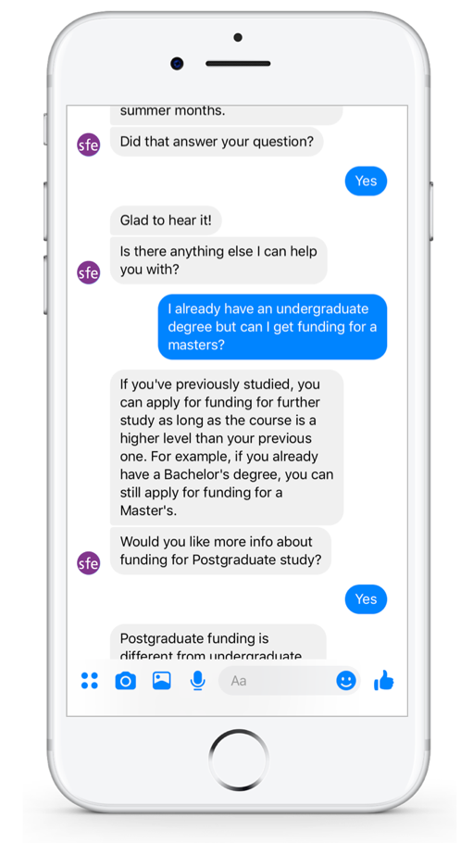
OPPORTUNITY
An AI chatbot can be trained to handle a portion of customer queries, relieving load on contact centre staff and supporting the shift to digital channels.
The Social Media Survey shows that the more queries can be resolved through Facebook and Twitter, the fewer customers will contact SFE via telephony. Deploying a chatbot would reduce waiting times for customers and improve the consistency of responses, and allow social media advisors to focus on more complex cases. Over time, the chatbot can be trained to handle increasingly complex tasks and can be integrated with RPA robots to achieve greater levels of automation. Some key benefits of chatbots are:
✓
Reduction of contact centre traffic
Chatbots can completely resolve many customer queries and filter traffic away from human advisors.
Ability to meet seasonal surges in demand
Chatbots can handle many concurrent interactions and are scalable to cope with different levels of traffic.
Increased quality and consistency
Ensure customers receive consistent and standardised responses to queries.
Improved compliance and auditability
Customer interactions can be securely recorded to increase visibility and the capture of information.
Increased service hours and languages
In principle, chatbots can run 24/7 and support multiple languages aside from English.
✓
✓
✓
✓

Slide 4



APPROACH
The value of the chatbot is increased exponentially as greater integration into SLC’s backend IT systems is undertaken.
TEXT CHATBOT
(Non Integrated)
TEXT CHATBOT
(Application Integration)
VOICE CHATBOT
(IVR Integration)
✓
Able to answer FAQ style queries
✓
Enhanced Chatbot with the ability to respond with Account-specific answers
✓
Leverages foundations of Text Chatbot platform to reduce calls routed to Contact Centres
✓
No Integration to SLC Backend systems required
✓
Integration into SLC Backend systems to determine Application Status, Evidence Received etc.
✓
Chatbot integrates into the IVR system to answer call queries through voice
✓
Rapid Delivery utilising Cloud Based services
✓
Integration into Social Media Channels (Facebook / Twitter)
✓
Greater prevention of subsequent phone calls
✓
True omni-channel service with key contact metrics across digital and contact centres
INCREASING COMPLEXITY
LOW
MEDIUM
HIGH

Slide 5
BUSINESS CASE: SOCIAL MEDIA
The chatbot would be expected to drive significant cost and time savings:
Average inbound messages on social media: 23,800/month
Average messages handled by social media advisors: 11.79/hour
Average handling time per message: 5.09 mins
Handling time for ‘simple’ message (20% of average): 1.02 mins
Average cost per message for Social Media advisor: £0.80
Cost per message for chatbot: £0.002
Assumptions:
Social media volumes based on 12 months to March 2019
SM advisor message cost based on messages sent by SM team (not all messages can be responded to)
Handling time of ‘simple’ messages based on 80:20 split of complex/simple queries
Chatbot costs based on using IBM Watson for NLP
Time savings based on 7.5 hours/day
Infrastructure cost estimated £3000/month for environments, DevOps tooling, etc.
For each message handled by chatbot vs advisor
Saved time (mins) | 1.02
Saved money (advisor cost minus bot cost) | £ 0.798
 | Proportion of annual messages handled by chatbot
 | 20% | 40% | 60% | 80%
Messages per year | 57,120 | 114,240 | 171,360 | 228,480
Saved time (working days) | 129 | 258 | 388 | 517
Savings per year (minus infrastructure cost) | £ 9,582 | £ 55,164 | £ 100,745 | £ 146,327

Slide 6
BUSINESS CASE: TELEPHONY
Longer term, deploying the chatbot on the telephony channel would yield much larger savings:
Average calls per month for top 10 reasons: 144,635
Average handling time per call: 5 mins
Average cost per call with advisor: £5.00
Cost per call for chatbot: £0.10
Assumptions:
Call volumes based on SFE top call reasons April 2017 to March 2018
Call handling time estimated at 5 mins – to be validated
Call cost based on non-specialist call to SFE
Chatbot costs based on IVR solution deployed at Irish Revenue based on multi-step dialogue using Microsoft or IBM for NLP, Speech to Text and Text to Speech APIs.
Time savings based on 7.5 hours/day
Infrastructure cost estimated £3000/month for environments, DevOps tooling, etc.
For each call handled by chatbot vs advisor
Saved time (mins) | 5
Saved money (advisor cost minus bot cost) | £ 4.90
 | Proportion of annual calls handled by chatbot
 | 1% | 5% | 10% | 20%
Calls per year | 1446 | 7231 | 14463 | 28926
Saved time (working days) | 193 | 964 | 1928 | 3857
Savings per year (minus infrastructure cost) | £ 49,045 | £ 389,226 | £ 814,452 | £ 1,664,905

Slide 7



BUSINESS CASE: OTHER BENEFITS
Aside from the direct benefits of cost and time savings, implementing chatbots can provide value in various other areas.
Growing ‘New IT’ skills in SLC
Artificial Intelligence, including Natural Language Processing, speech recognition and generation
Knowledge modelling, conversational scripting
Architecture and DevOps, use of Continuous Integration and deployment pipelines including Kubernetes and Docker
Improving employee experience
Filtering-off simple, repetitive questions from advisors
Relieving pain points around repetitive frustrating tasks like authentication
Empowering advisors to contribute to knowledge modelling and maintenance of content
Potential to improve staff retention as a result
Improving customer experience
Reducing waiting time for customers to get their query resolved
Increasing transparency around waiting/processing times to manage customer expectations
Increasing consistency of responses so customers don’t get conflicting information from different sources, helping to increase trust in SLC

Slide 8
INDICATIVE DELIVERY PLAN
The chatbot can be built iteratively, starting with limited scope and channels in order to get to a customer pilot as quickly as possible and with minimum investment. Once value has been proven in the pilot, further enhancements can be pursued.
Apr-19 | May-19 | Jun-19 | Jul-19 | Aug-19 | Sep-19 | Oct-19 | Nov-19 | Dec-19 | Jan-20 | Feb-20 | Mar-20
Phase 1: MVP
Facebook Messenger, no customer authentication,
no SLC systems integration
Go/No-Go
to continue
Discovery and Mobilisation
Phase 2: Application Integration
Facebook Messenger (+ Twitter), customer authentication and integration to certain SLC systems to provide more specific help
Go/No-Go
to continue
Conversation Design
* Alternative option to progress immediately to Telephony
Phase 3: Telephony Integration
Integrate with IVR, enable voice services
Set up infrastructure
Build, Train and Deploy
User Testing
Controlled Customer Pilot
Continuous improvements to existing customer-facing chatbot
Maintenance and training of use cases on social media
Build roadmap and detailed plan for scaling
Define future architecture blueprint

Slide 9
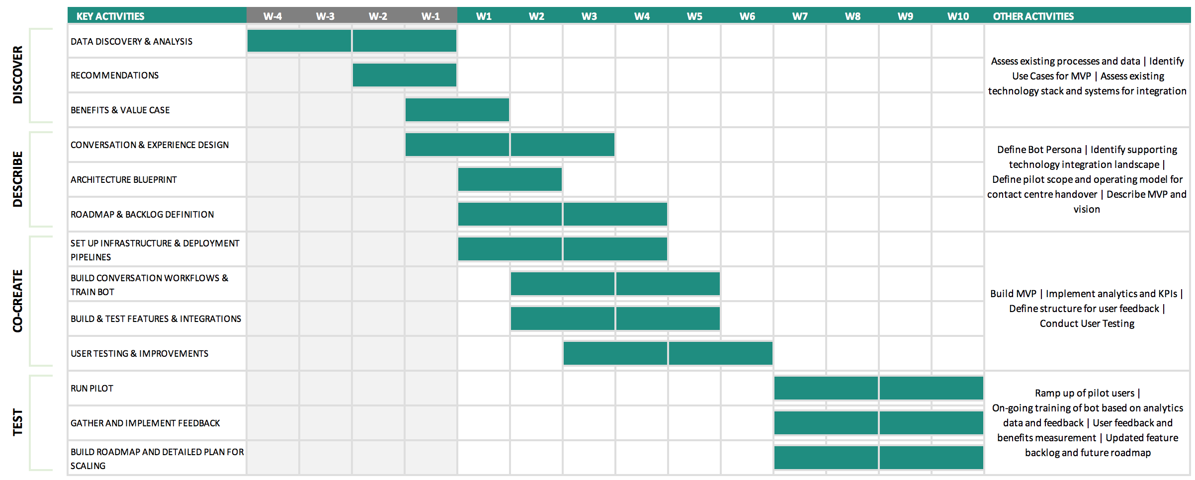
MVP ROLLOUT PLAN
A more detailed view of the initial MVP phase is shown below. Some Discovery activities have already been completed.

Slide 10
STAFFING PROFILE
The below staffing profile is proposed to deliver the MVP solution and pilot.
 |  |  |  | BUILD & TEST |  |  |  |  |  | RUN PILOT
Resource | Bill Rate | Days | Cost | W1 | W2 | W3 | W4 | W5 | W6 | W7 | W8 | W9 | W10
AI Architect | 1100 | 20 | £22,000 | 2 | 2 | 2 | 2 | 2 | 2 | 2 | 2 | 2 | 2
Scrum Master | 745 | 49 | £36,505 | 5 | 5 | 4 | 5 | 5 | 5 | 5 | 5 | 5 | 5
Conversation Designer | 0* | 30 | £0 | 3 | 3 | 3 | 3 | 3 | 3 | 3 | 3 | 3 | 3
Conversation Developer | 0* | 29 | £0 | 5 | 5 | 4 | 5 | 5 | 5 | 0 | 0 | 0 | 0
Full Stack Developer | 745 | 49 | £36,505 | 5 | 5 | 4 | 5 | 5 | 5 | 5 | 5 | 5 | 5
Business Analyst / Tester | 550 | 49 | £26,950 | 5 | 5 | 4 | 5 | 5 | 5 | 5 | 5 | 5 | 5
DevOps | 550 | 20 | £11,000 | 2 | 2 | 2 | 2 | 2 | 2 | 2 | 2 | 2 | 2
*already covered by existing SOW
Total man days: 246
Total cost: £132,960

Slide 11







ROLE DESCRIPTIONS
The roles outlined in the staffing profile will be responsible for the below key activities.
AI Architect
Provide expertise in AI services and define the overall future architecture blueprint.
Scrum Master
Facilitator between business and scrum team, ensuring any blockers facing the scrum team are resolved.
Conversation Designer
Design experience and interactions between the chatbot and users; design and create the knowledge/semantic model and support its ongoing training.
Conversation Developer
Develop decision trees and corresponding knowledge model to support conversation design.
Full Stack Developer
Develop and integrate end-to-end technology stack, from front to back-end including handover to Hootsuite.
Business Analyst/Tester
Analyse data, test the solution and conduct ongoing process discovery activities.
DevOps
Set up CI pipelines, environments and automation for the solution.

Slide 12
USE CASE OPTIONS FOR INITIAL ROLLOUT
Focusing on the types of queries that represent high volume and low complexity will maximise the impact and minimise the time and cost to deliver an MVP. The below use cases are based on FAQs from Twitter/Facebook and The Student Room, and can be answered without having to identify or authenticate the customer.
Topic | Use Case | Example Question
Evidence | Evidence requirements | What evidence do I need to prove my residency?
 | Evidence format | Can I send a photocopy of my passport or does it have to be the original?
 | Evidence received? | I sent my bank statements in last week – have you got them yet?
 | Tax year for household income | If I’m going to uni in September do I need to show my household income for tax year 2018/19 or 2019/20?
 | Returning students | I’ve applied for finance for my second year - do I need to submit all my evidence again?
 | Sponsor info | Do my parents need to tell you their income for me to get a loan?
Eligibility | EU students & migrant workers | I’m from the EU but applying for a course in the UK. Can I get a loan?
 | Previous study | I already have a degree but I want to do a masters. Can I get funding?
 | Postgraduate loans | Can I get a tuition fee loan and maintenance loan for my PhD?
 | Exception courses | I want to do a nursing course – can I get funding?
 | Part time courses | Can I get funding if I’m studying part time?
 | UK citizens abroad | I’m British but have been living abroad recently. Can I get a loan?
 | Final year entitlement | Why is my loan amount smaller in my final year?
 | Funding duration | Is it true I can only get funding for 4 years?
Topic | Use Case | Example Question
Application | Service launches (postgraduate/part time/EU…) | When do applications open for postgraduate courses?
 | Deadlines (new/returning/postgraduate/EU/part time…) | When’s the closing date for applications for EU students?
 | Course not confirmed | Can I still apply even if I haven’t confirmed my course yet?
 | Bank account info | I don’t have my own bank account yet, can I still apply and change it later?
 | Credit checks | Will getting a student loan affect my credit score?
 | UK residency | I live in Scotland but am going to uni in England. Do I apply to SFE?
 | Returning students | Do I have to apply again next year?
 | Processing times | When will my application get approved?
Payment | Reasons for Blocked payment | In my online account it says my payments are blocked. Why?
 | Reasons for Failed payment | Why does my payment show as Failed?
 | Payment schedule | When will I get paid?
Change of Circs | Withdrawal/Suspension | What happens to my funding if I drop out?
Other | Brexit | Will my funding be affected by Brexit?

